Slide 1

Session 2
Setting up Game Terrain

Slide 2
Session Overview
In this session, you will learn to:
Explain Terrain
Explain how to draw shapes
Create game environment
Notes:
Instruction(s) to the trainer:
Begin the session by giving a basic introduction to the session.
Conclude this screen by listing down the objectives of the session.
Quick Tips:
Before commencing the session, students may express their knowledge about previous session.

Slide 3
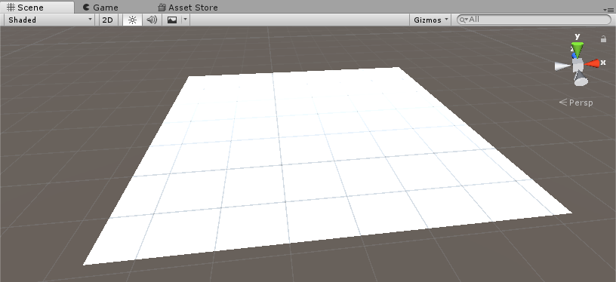
Creating Terrains
New Terrain
Notes:
Instruction(s) to the trainer:
Explain what is terrain and why to use.
Explain to students how they can draw a terrain.
Explain how to change different terrain properties and terrain size.

Slide 4
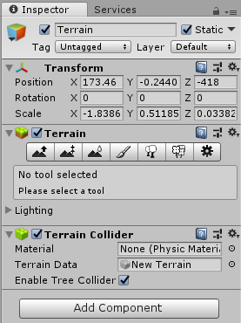
Terrain Settings
1-3
Terrain Settings
Terrain Inspector
Notes:
Instruction(s) to the trainer:
List all the options available for terrain.
Explain and demonstrate different terrain settings.
Show with an example

Slide 5
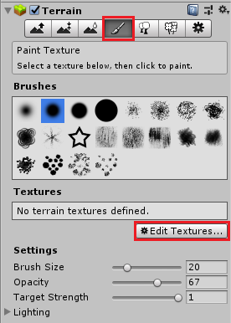
Terrain Settings
2-3
Adding Texture to Terrain
Paint Texture Window
Notes:
Instruction(s) to the trainer:
Explain and demonstrate the process of adding texture to the terrain surface.
Use all the available options to change the terrain texture.
Explain different brush options.

Slide 6
Terrain Settings
3-3
Adjusting Terrain Height
Terrain Height Tools
Notes:
Instruction(s) to the trainer:
Explain how to add terrain height.
Use the Raise/Lower Height Tool to create different heights on the terrain.
Use Paint Height Tool and adjust the height value to adjust the texture paintings to a suitable height.
Use the Smooth Height Tool to smoothen the texture surfaces.

Slide 7
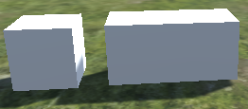
Importing and Drawing Objects
Drawing using the Editor and Draw Gizmos
You can give visual debugging or setup aids in the Scene view using gizmos.
Use the OnDrawGizmos or OnDrawGizmosSelected functions to draw gizmos.
Shape Scaling
Notes:
Instruction(s) to the trainer:
Draw different shapes and demonstrate how to scale them to form different shapes.
Explain and use the OnDrawGizmos or OnDrawGizmosSelected functions to draw gizmos.
Mention different methods to draw the gizmos.
Write a sample script and demonstrate the draw functions.

Slide 8
Developing the Game
1-7
Creating the following GameObjects for the Golf Mini game:
Golf table
Golf ball
Club
Hole for the Golf ball
Pivot Point
Notes:
Instruction(s) to the trainer:
Explain to students what features or modules of the game they will be developing in this session.
Explain what features and functionalities of Unity will be used for the game development.

Slide 9
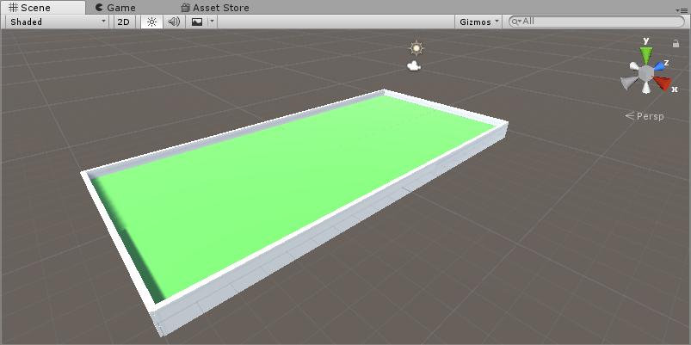
Developing the Game
2-7
Golf Table
Golf Table
Notes:
Instruction(s) to the trainer:
Draw the golf table using the Cube GameObject.
Explain why Cube has been used and why such approach has been taken.

Slide 10
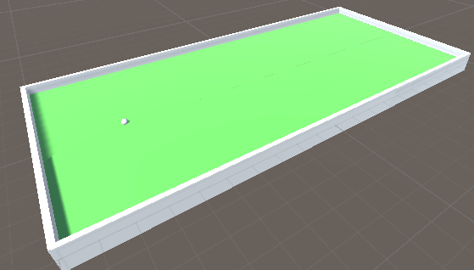
Developing the Game
3-7
Golf Ball
Golf Ball
Notes:
Instruction(s) to the trainer:
Explain and demonstrate how to draw the golf ball.

Slide 11
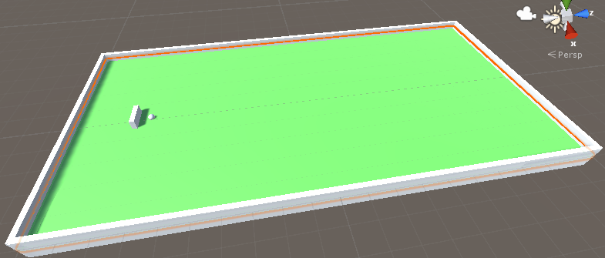
Developing the Game
4-7
Club
The player will hit the ball using the club. To create a club, first draw a cube. Scale and place the club near the golf ball.
Club
Notes:
Instruction(s) to the trainer:
Explain and demonstrate the use of golf Club and how to draw it.

Slide 12
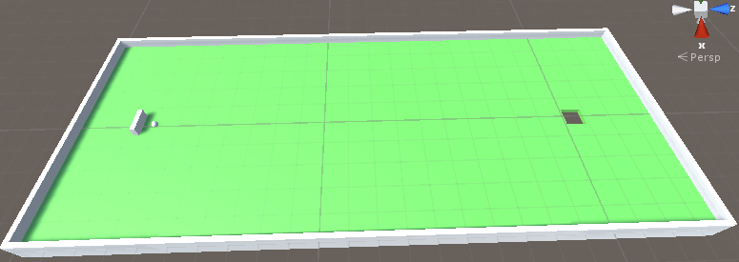
Developing the Game
5-7
Hole for the Golf ball
Hole for the Golf ball
Notes:
Instruction(s) to the trainer:
Explain the need of Hole for Golf ball.
Explain the process to draw the hole.

Slide 13
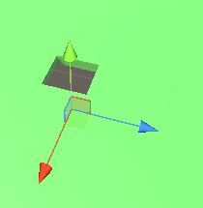
Developing the Game
6-7
Holder for the Ball
Holder for the Ball
Notes:
Instruction(s) to the trainer:
Explain the need of Holder for the Golf ball.

Slide 14
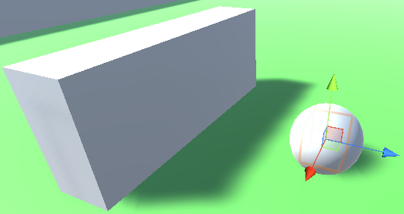
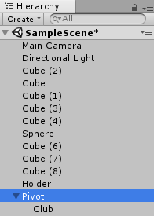
Developing the Game
7-7
Pivot Point
Pivot Point
Club under Pivot
Notes:
Instruction(s) to the trainer:
Explain why there should be a pivot point from the gameplay perspective.
Explain how to draw the pivot and make it ready to be used in the game.

Slide 15
Summary
1-2
Unity’s Terrain system allows you to add vast landscapes to your games.
To add a Terrain GameObject to your Scene, select GameObject →3D Object →Terrain from the menu.
The Terrain’s Inspector window provides a number of tools you can use to create detailed landscape features.
Use the height adjustment tools to vary the terrain heights.
Flatten button that levels the whole terrain to the chosen height.
You can draw a number of basic primitive shapes in Unity such as cube, sphere, cylinder, plane, and so on. You can then scale and rotate these objects to form other shapes.
You can also draw shapes in script using gizmos.
Notes:
For Slides 15 and 16
Instruction(s) to the trainer:
Summarize the session.
Highlight the key points covered in the session and provide an introduction of the next session.
Facilitate a group discussion; ask open-ended questions in relation to the session that was conducted.
Invite responses from the participants.

Slide 16
Summary
2-2
The golf table will be the first thing that you will draw using cube.
Apply to table a green color material.
Add four cubes and scale and position them to complete the table borders.
To create a golf ball, first draw a sphere, and scale it to required dimensions. Place the golf ball on the table.
To create a club, first draw a cube, and scale it to required dimensions. Place the club near the golf ball.
Create an invisible object on the game ball around which the club will rotate.

Slide 17
Knowledge Check
1-5
Q1. To create a golf ball, first, draw a ________.
Sphere
Cone
Circle
Triangle
Notes:
Discuss Knowledge Check questions from Slide 17 to 21
Answer(s):
a. Sphere

Slide 18
Knowledge Check
2-5
Q2. In the Hierarchy window, place the Club under _____.
Pivot
Axis
Gizmo
Mesh
Notes:
Answer(s):
a. Pivot

Slide 19
Knowledge Check
3-5
Q3. _______ is used to draw a texture in the Scene.
OnDrawGizmos();
DrawGUITexture();
DrawRay();
DrawWireMesh();
Notes:
Answer(s):
b. DrawGUITexture();

Slide 20
Knowledge Check
4-5
Q4. The second tool from the left is the _________.
Smoothness
Offset
Raise/Lower Height
Paint Height
Notes:
Answer(s):
d. Paint Height

Slide 21
Knowledge Check
5-5
Q5. The ____ property determines how far from the terrain’s anchor point the tiling will start.
Select Texture2D
Add Terrain Texture
Offset
Size
Notes:
Answer(s):
c. Offset

